Slide 1
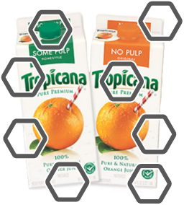
High-speed Fill
Technology
Breakthrough Concept
Coating Technology
Exclusive Rights to
Technology
Proprietary Manufacturing
Equipment
Skiving Technology
Award-Winning Design
Folding Carton Technology
Notes:
1
1

